Slide 1
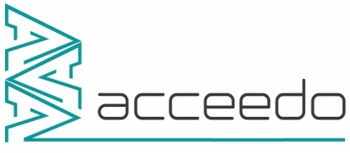
“Implementation of industry 4.0 at SVIC & interactions”

Slide 2
Agenda
Journey of Integrated Software & IoT
Implementation overview @ SVIC
Multi brain Approach
About Acceedo
Question

Slide 3
Journey of Integrated Software & IoT @ svic`
Solution
Communication Gap
Unpredicted breakdowns
Machine Health & Process Control
Employee management
Scheduling & Target Displayed
learning breakdowns
Continuous monitoring
Employee time/payroll management
Data Sharing regularized
Increase in production
Machine lifespan improved
Management Effort reduced
Difficulties
What we archived

Slide 4
Topic-1
Communication Gap

Slide 5

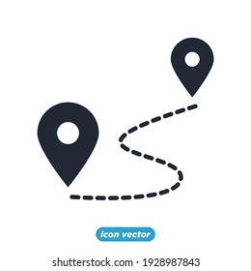



Why we had a Communication Gap ?
Industrial noise
Distance office - factory
Priority changes !
worker understanding ?
What’s happening in Production ?

Slide 6
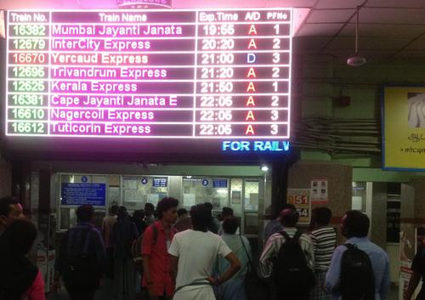
Railway Environment as an example
Enlarge Display
keep the passenger informed about train details
To Convey the Emergency message
Change in priority of train
Running Status of Train

Slide 7
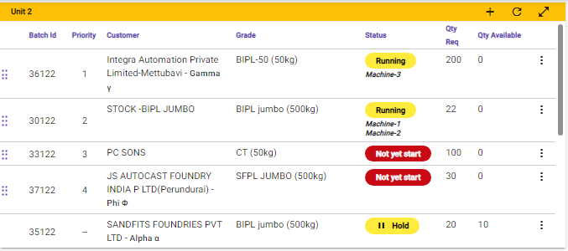
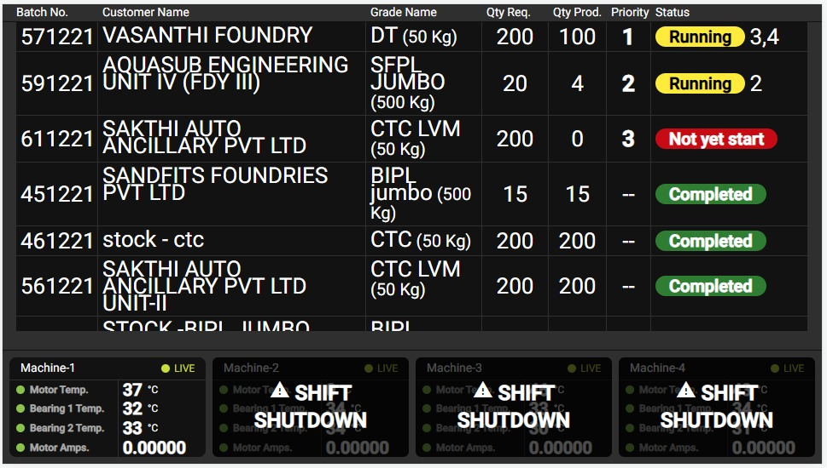
Svic Planning & Scheduling Management
Unique Office Software
Factory display
“Industry 4.0 touches everything in our daily lives”

Slide 8
SVIC SCHEDULE & TARGET DIsplay

Slide 9
Topic-2
Periodic Maintenance/ Breakdown

Slide 10
Periodic Maintenance
Every day there is a need to check the activity performed on equipment to maintain smooth operation of machine
Example
BEARING OIL CHECK
Sieve Condition
Panel Board Clean
Etc..
When factory has been opened the operator is informed to acknowledge a set of checklist (Periodic maintenance)
If the acknowledgement is not completed an intimation is provided to the office and mobile app.

Slide 11
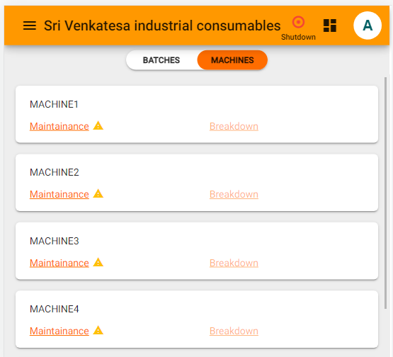
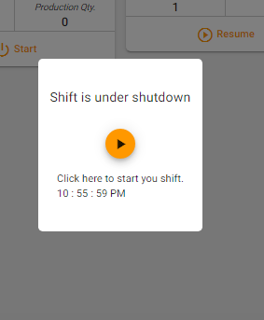
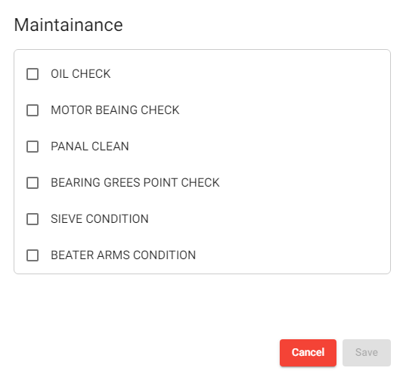
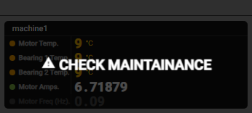
Periodic maintenance

Slide 12
Breakdown
Breakdown is an emergency in which the equipment is operated until it fails and then it is brought back into running by repair.
In Svic , breakdown is identified and the alarm is triggered.
Then the reason for breakdown is collected via mobile app and saved for further study.
This practice & continuous study of the breakdown data has brought awareness in equipment failure root cause and significantly decreased the breakdown.

Slide 13
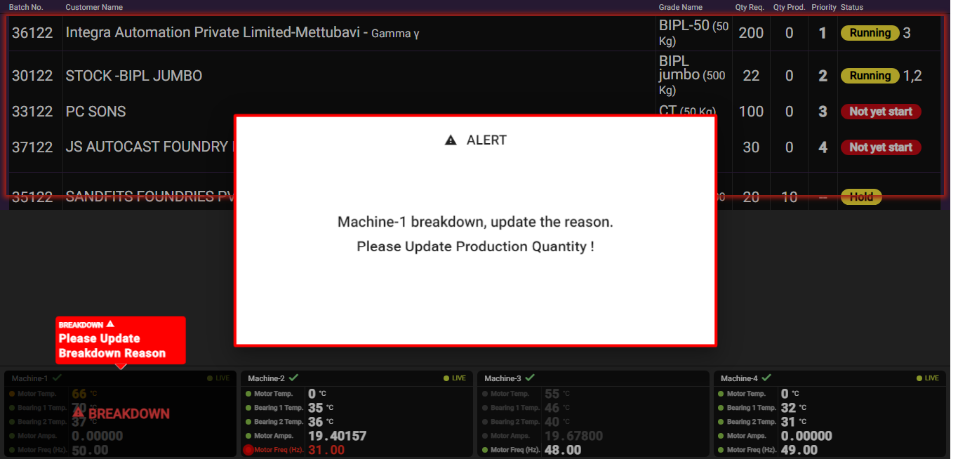
Software Supervise machine Breakdown

Slide 14
Topic-3
Machine health

Slide 15
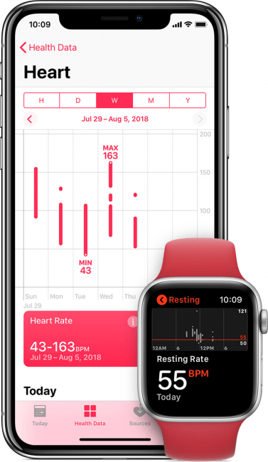
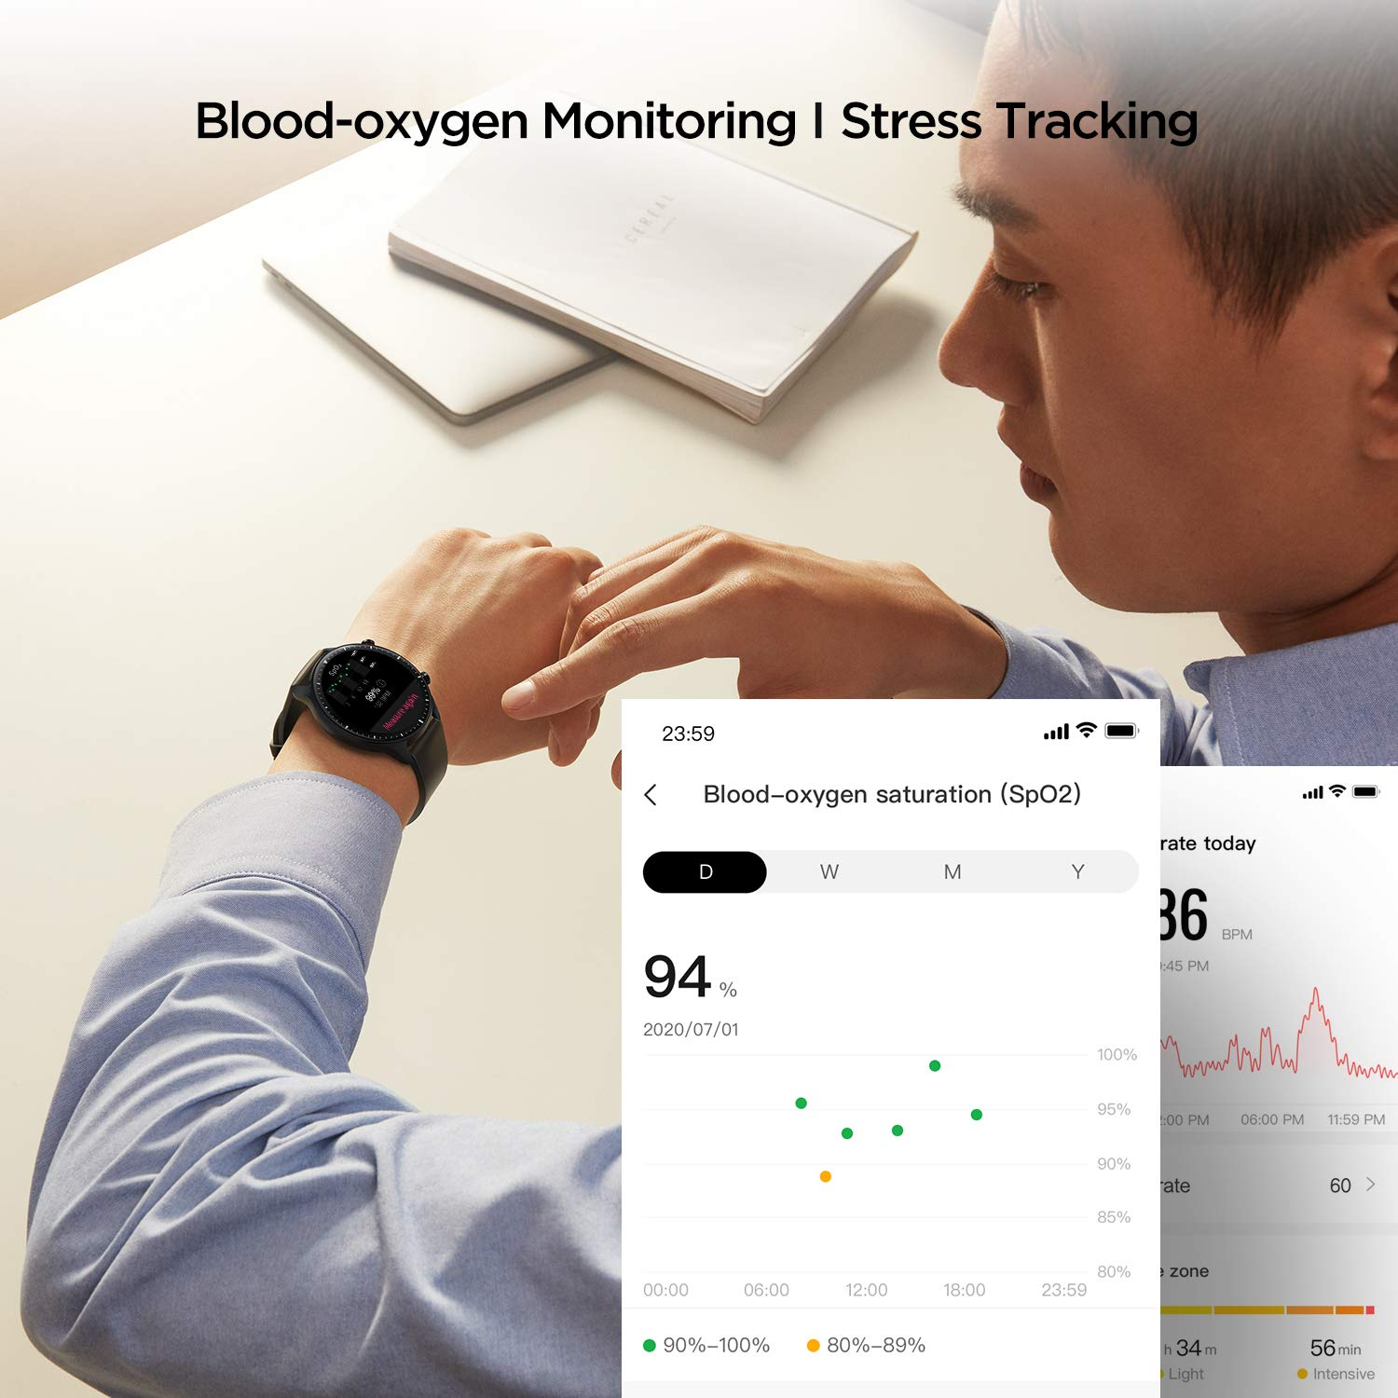

Smart Watch Health Monitoring

Slide 16


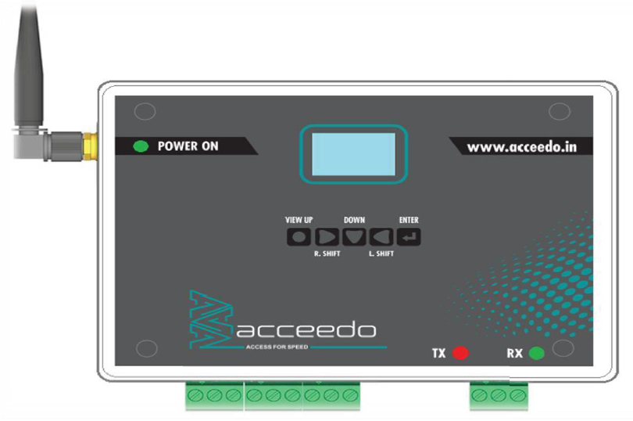
TV DISPLAY
Machine Status
Live Monitoring
Machine Health
Machine Health
Schedule & target
Parameter Control
ACCEEDO DATA COLLECTION BOARD

Slide 17
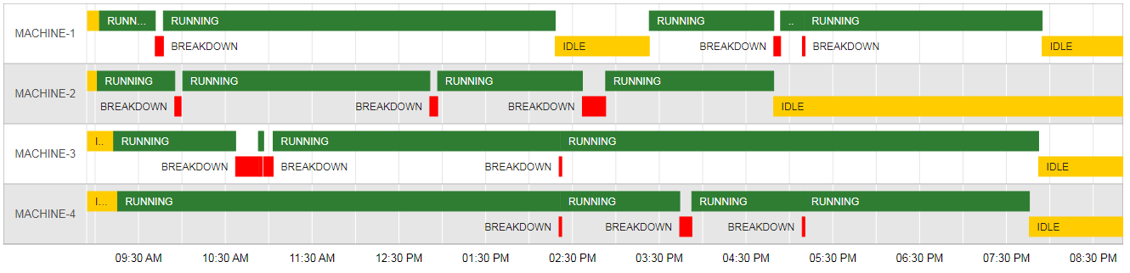
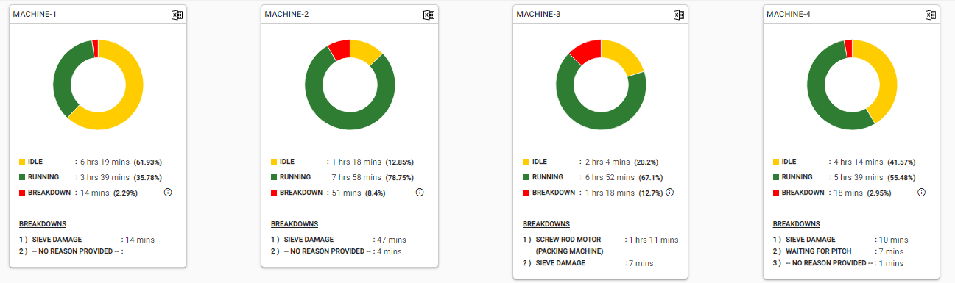

Slide 18
Difficulties Machine Health
Anyone can change the parameter
Physical presence for Monitoring
Manual data logging
No visibility for setting changes
understanding
Priority mismatched
document maintaining
Production status

Slide 19
Topic-4
Loading Dispatch

Slide 20
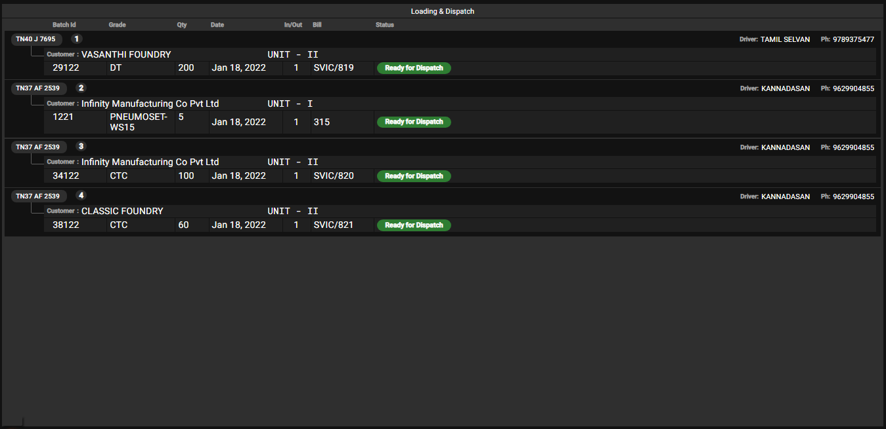

Slide 21

Moulding
Core making
Melting
Heat treatment
Fettling
Machine
Production
Maintenance
Attendance
Heat treatment
Multi Brain Approach
Single Brain Approach

Slide 22
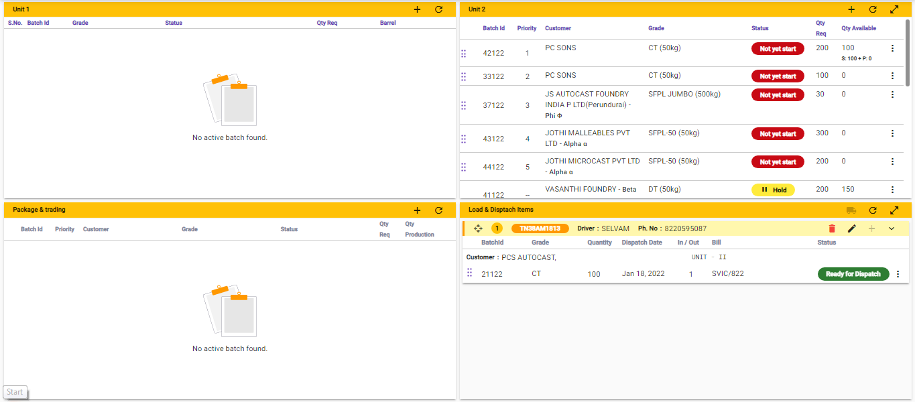

Slide 23

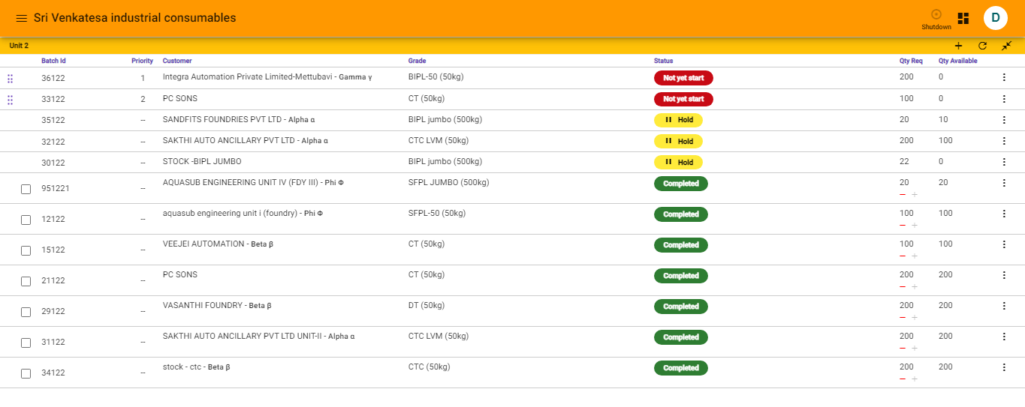
TV DISPLAY
Machines
SCHEDULE & TARGET
Machine Status
Live Monitoring
Machine Health
Machine Health
Schedule & target
Parameter Control
Acceedo – smart device

Slide 24

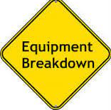
Loads Item Config
Into the machine
Makes Schedule
Loading Instruct
Order
Target Priority List
Machine Monitoring
Dispatch
Makes Schedule
Loads Item Config into the machine
Machine monitoring
Breakdown
Dispatch

Slide 26
“Industry 4.0 touches everything in our daily lives”
“Industry 4.0 integrates the digital and physical worlds”
“It’s not just about the supply chain or manufacturing–it’s about business operations
and revenue growth”
Notes:
1. “Industry 4.0 touches everything in our daily lives”
I4.0 does not just touch ‘manufacturers’ but all of us
I4.0 will change how we make things but it could also affect how those things are moved, how customer interact with them and the experience they expect to have as they interact with companies
Beyond that, it could drive changes in the workforce, requiring new skills and roles.
Good example: this is the reason why we have to study this course!
2. “Industry 4.0 integrates the digital and physical worlds
- Beyond the digital thread, the use of the digital twin can enable organizations to gain insight into the inner workings of systems or facilities, simulate possible scenarios, and understand the impacts of changes in one node on the rest
of the network.
3. It’s not just about the supply chain or manufacturing–it’s about business operations and revenue growth
I4.0 is broader than just supply chain or production: Industry 4.0 capabilities can improve business operations and revenue growth, transforming products, the supply chain, and the customer experience.
Impact on product: transform the way products are designed and developed. Lead to business model.
Impact on supply chain: I4.0 enables the smart factory, connect supply network and logistics capabilities and inform planning and inventory processes
Impact on customers: enhance the customer experience, direct selling and marketing strategies though data gathered though intelligent products and services. Customers can interact with the object.

Slide 27
Lets look at live data
Thank You for your Time.

